Slide 1
Team 304 Project Presentation 1
Jose Aguilar, Ivan Makarenko, Kezmen Lozevski,Timothy Drafz,
Roshan Patel

Slide 2
Team organization
Team Charter:
Gain more insight on creating electronic systems utilizing industry level software such as Orcad Cadence, and MPlab.
Gaining more experience in the design and construction of different serial sensing and actuation circuits.
Demonstrating a neat project to friends and family.
Expanding our project resume with an interesting design that conveys what we learned throughout the course.
Gaining more confidence and familiarity with electrical systems in general to give us a higher repertoire of skills when handling future electrical system tasks.
Mission Statement:
To create a device that uses multiple unique sensors to take input from its environment and perform a meaningful or beneficial task.

Slide 3
Design Concepts

Slide 4
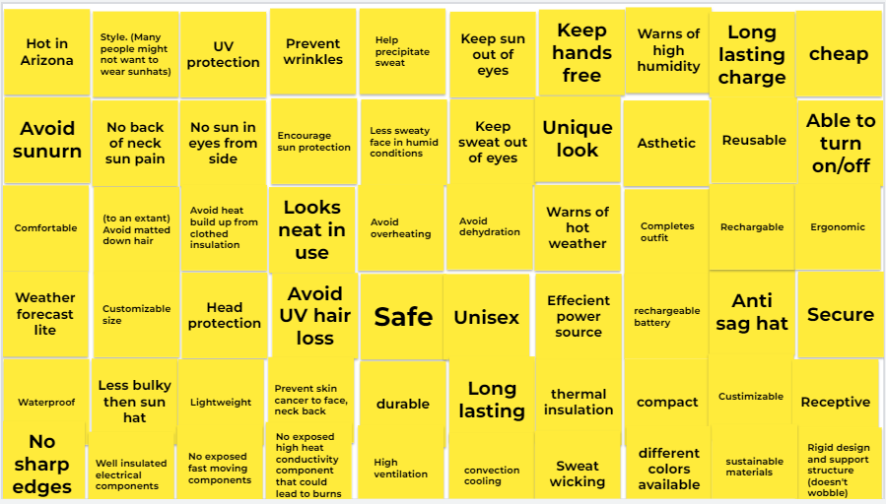
User needs

Slide 5
User needs (categorized)

